Slide 1
Step Size & Instability for the Logistic Population Equation

Slide 2
This project was adapted from a significantly smaller project in: Fundamentals of Differential Equations. Eighth Edition. Nagle, Saff, and Snider. Pg. 151-152

Slide 3
Background

Slide 4


$$\frac{dp}{dt}=10p\left(1−p\right)$$ $$p\left(0\right)=0.1$$
Logistic Equation for population growth
$$p\left(0\right)=0.1$$
More information: https://en.wikipedia.org/wiki/Logistic_function

Slide 5

Solution:
$$p\left(t\right)=\frac{e^{10t}}{e^{10t}+9}$$

Slide 6
Bifurcation Diagrams

Slide 7
Bifurcation Diagrams
Show values converged to depending on an input parameter
Often used for illustrating chaos in dynamic systems
We will use them to illustrate chaos arising out of instability in numeric methods
Source/more background: https://en.wikipedia.org/wiki/Bifurcation_diagram

Slide 8

Convergence?
$$\lim_{t→∞}{\frac{e^{10t}}{e^{10t}+9}}=1$$

Slide 9
Euler’s Method

Slide 10


Slide 11


Slide 12
Runge-Kutta 4

Slide 13
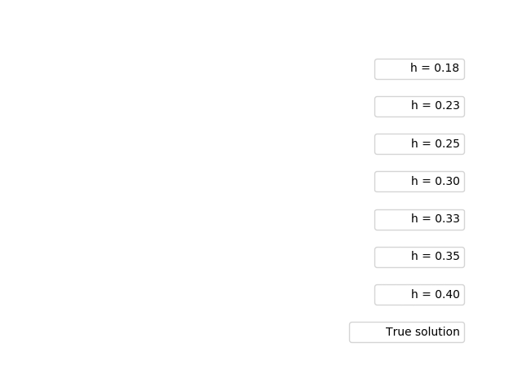

Slide 14


Slide 15
Things that didn’t work…
Backwards Eulers (Newton’s method failed to converge)
Predictor corrector (adams bashforth/moulton 4th order)
Adams bashforth
Rearranging pc4
Predictor corrector 2nd order adams bashforth/ moulton

Slide 16
Backwards Euler’s (Newton’s method failed to converge)

Slide 17
Predictor Corrector (Adams-Bashforth / Adams-Moulton 4th order)

Slide 18

Note that the step size at which pc4 devolves into chaos is around 0.175, which is smaller than 0.18 for which Euler’s converged to the correct value.

Slide 19
Adams-Bashforth (4th order)

Slide 20
Adams-Bashforth (4th order)

Slide 21

Note that the step size at which Adams-Bashforth alone devolves into chaos is even smaller (~0.7 vs ~0.175) than for pc4.

Slide 22
Rearranging math in Predictor Corrector (Adams-Bashforth / Adams-Moulton 4th order)

Slide 23

Note that this is the same diagram as for the original Predictor / Corrector

Slide 24
Exactly the same…

Slide 25
Predictor Corrector (Adams-Bashforth / Adams-Moulton 2nd order)

Slide 26

Somewhat disappointing…

Slide 27
Correcting Adams-Bashforth helped… What about other implicit methods?

Slide 28
Trapezoid

Slide 29


Slide 32
Why are linear multi-step methods worse than single-step here?

Slide 33
“When multistep numerical methods are used, instability problems may arise that cannot be circumvented by simply choosing a sufficiently small step size h. This is because multistep methods yield ‘extraneous solutions,’ which may dominate the calculations….”
Source: Fundamentals of Differential Equations. Eighth Edition. Nagle, Saff, and Snider. Pg. 150

Slide 34
But why?

Slide 35
Some really complicated stuff, that’s why.

